Slide 1
Impact Review: Communication Permissions
(aka Notification Settings)
Authenticated Experience
Ana Jakabcin, Marci McGuire & Heather Justice - Authenticated Experience, Product Managers
01/28/22

Slide 2
Start here
<Initiative> Impact Review, DD/MM/YY
Please maintain the slide style, fonts, and formatting when crafting your deck.
Don’t forget to complete the footer of the first intro slide.
Ensure each slide after the intro has a title and header, including DD/MM/YY.
Answer bolded questions, consider (and then delete) italicized questions
Charts, graphs, and images should have captions, titles and axis labels.
Add a thin border to any visuals and make sure it fits on the slide entirely (see Slide 4 for an example)
Remove any blank slides.

Slide 3
Problem
Communication Permissions Impact Review, 01/28/22
What Veteran-oriented problems did you attempt to solve?
The VA is ramping up their digital communications efforts, specifically through email and text. As a result, veterans need to be able to opt in or out of communications and customize through which channels they prefer to be contacted.
How does solving this problem contribute to OCTO’s North Star(s)?
Logged-in users have a personalized experience with the ability to set their communication permissions for various types of notifications within their VA.gov profile
Logged-in users can manage their communication permissions in one place at any time
Any updates veterans make to their permissions will be saved/accessed across the VA seamlessly
Why is solving this problem a priority vs. other problems?
We know veterans expect to set communication permissions from the VA.gov profile. We also know that veterans expect these settings to be synced across the VA, so that they do not have to manage different kinds of communication permissions in several different places.
What organizational challenges did you go after?
To meet these organizational and user needs, the VA Profile team built a communications permissions engine that will integrate with the VA.gov profile frontend and allow veteran-managed settings to be saved and shared across systems at the VA.

Slide 4
Hypotheses, Solutions
Communication Permissions Impact Review, 01/28/22
Hypotheses
Veterans expect to set notification settings from the VA.gov profile.
It will be fast and easy for us to add in new notification settings after the initial infrastructure is in place.
Solution(s)
Veterans expect to set notification settings from the VA.gov profile
Include a section in the VA.gov profile where veterans can set and manage permissions at any time.
Integrate with the VA Profile backend so VA.gov can display all the permissions which a user is eligible to set, retrieve existing permissions, and send updated permissions from the VA.gov profile to the VA Profile backend.
It will be fast and easy for us to add in new settings after the initial infrastructure is in place
The actual notification types for a which a veteran can set permissions are pulled in from VANotify.
Groupings (eg. notification categories) are pulled in dynamically from VA Profile
Communication channels (eg. email, text) are pulled in dynamically from VA Profile

Slide 5
Results
Communication Permissions Impact Review, 01/28/22
Launch date: 11/16/2021
Phased launch over 2-week period
Began November 3rd at 25%
Impact on Users, Business, and/or Technology
Notification Preferences - Google Analytics dashboard
Key result #1: Increase the number of profiles that have mobile phone numbers and email addresses by 15% each on a quarterly basis.
KPI/metric | Baseline (4.30.21; 15,329,217 veterans) | Baseline before launch (11.3.21; 15,739,528 veterans) | % of profiles with this info at 3 months (Nov - Jan; 16,883,386 veterans) | % of profiles with this info at the end of Q1 2022 (Jan - Mar)
# of profiles with mobile phone saved in VA Profile backend* | 7,759,973 (50.6%) | 8,121,902 (52%) (9.5% more mobile numbers) | 8,420,023 (50%) (9.6% more mobile numbers) | TBD
# of profiles with email addresses saved in VA Profile backend* | 6,367,462 (41.5%) | 6,745,859 (43%) (9.4% more email addresses) | 6,963,396 (41%) (9.6% more email addresses) | TBD
Notes:
9.7% increase of VA.gov profiles from April to November
9.3% increase of VA.gov profiles from November to Jan
The 54% unique saves is inline with the number of profiles with mobile phone or email address information:
16,883,386 veterans
8,420,023 mobile phone numbers (50%)
6,963,396 email addresses (41%)
These figures are about 9.6% higher than they were before launch in November, however we could see about the same increase in volume between May and November (9.5%). I find this an interesting metric, and wonder if we would have had the same increase in these user points if we had not added the Notification Settings to our Profile page. (perhaps we can save that convo for the Impact review).

Slide 6
Results
Communication Permissions Impact Review, 01/28/22
Key result #2: 60% of first time users of Notification Settings have set at least one of the three notification settings, available at launch within the first quarter of launch.
KPI/metric | Baseline immediately before launch (date TBD) | % of profiles with saved settings at 3 months (Nov - Jan) | % of profiles with saved settings at the end of Q1 2022 (Jan - Mar)
% of profiles with notification settings saved | 0% (new feature) | 54% | TBD
Key result #3: Maintain at least a 95% success rate for successful saves of notification settings information.
Key result #4: Maintain at least a 95% success rate for retrievals of notification settings.
KPI/metric | Success rates 1 month after launch | Success rates at the end of Q4 2021 (Oct - Dec) | Success rates at the end of Q1 2022 (Jan - Mar)
95% successful retrievals | 99.9% | 99.9% | TBD
95% successful saves | 99.9% | 99.9% | TBD
Notes:
This measures users who accessed the Notification settings page and made updates that were saved (unique events/sessions)
54% - used Post Comm successful (30,629) divided by Get Comm started (56,626)

Slide 7
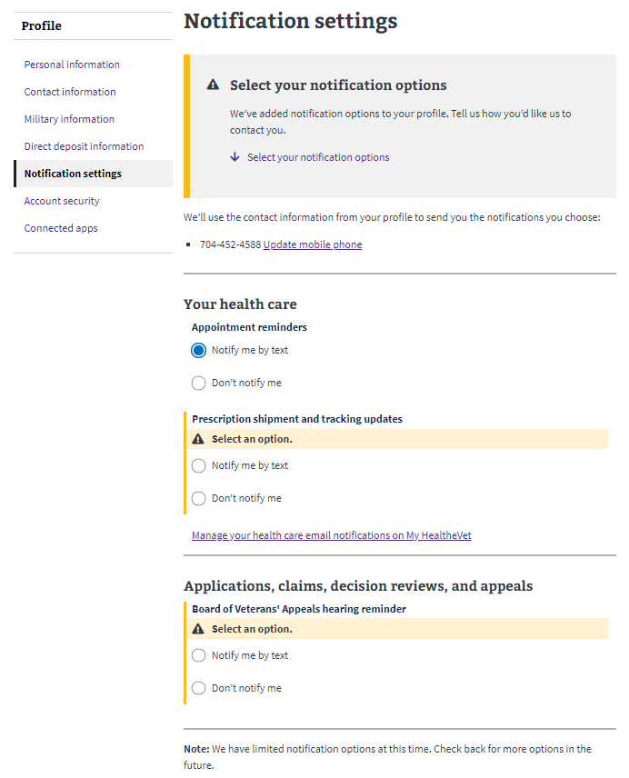
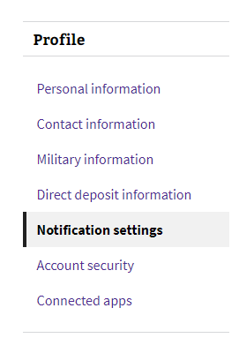
Look at what is new!
Communication Permissions Impact Review, 01/28/22

Slide 8
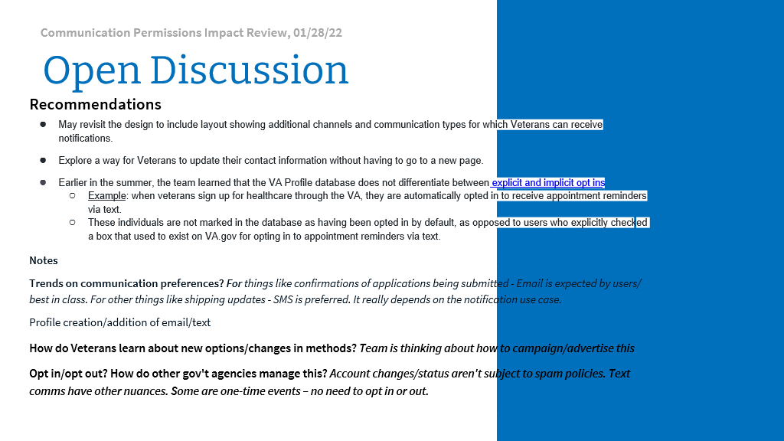

Slide 9
Open Discussion
Communication Permissions Impact Review, 01/28/22
Recommendations
May revisit the design to include layout showing additional channels and communication types for which Veterans can receive notifications.
Explore a way for Veterans to update their contact information without having to go to a new page.
Earlier in the summer, the team learned that the VA Profile database does not differentiate between explicit and implicit opt ins
Example: when veterans sign up for healthcare through the VA, they are automatically opted in to receive appointment reminders via text.
These individuals are not marked in the database as having been opted in by default, as opposed to users who explicitly checked a box that used to exist on VA.gov for opting in to appointment reminders via text.
Notes
Notes:
Because default sends are not indicated in the database, we have no way of displaying that information on the frontend, which means when our notification settings feature launches, a Veteran may already be receiving text message appointment reminders, but when they first visit the notification settings feature the appointment reminder notification item will appear as though they are not opted in to receive notifications.
Proposed Solutions
We've had many discussions with VA Notify and VA Profile as to how we should resolve this issue. The first step is for VA Profile to enhance their database to include a flag or indicator of some kind to denote implied opt-ins (default sends) vs explicit opt-ins.
There have also been discussions as to whether there should be some kind of design element on the frontend to indicate that a user may be have been opted in impliciltly vs explicitly. The major question from our perspective is if this is coming from a personal preference on VA Notify's side, or if this is some broader legal or business reason that they are proposing this.

Slide 10



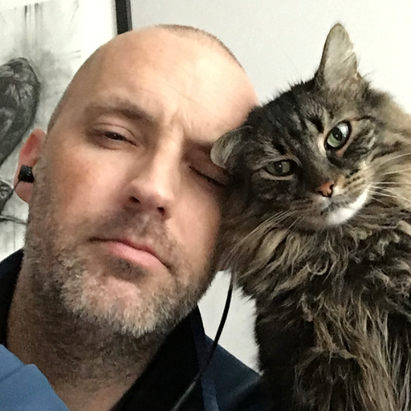


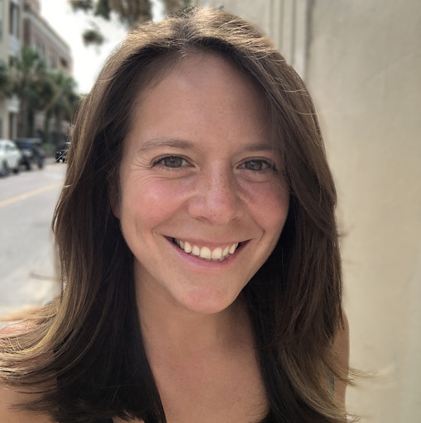


Authenticated Experience Team
Communication Permissions Impact Review, 01/28/22
Other contributors:
Steve Kovacs,
DEPO Product Owner
Mike Richard
VA Profile PM
Terry Bazemore
VA Profile Engineer
Samara Strauss, DEPO Product Owner
Ana Jakabcin,
Product Manager
Erik Hansen,
Frontend Engineer
Taylor Mitchell,
Frontend Engineer
Liz Lantz, Designer/Researcher
Tressa Furner,
Designer/Researcher
Lihan Li,
Backend Engineer

Slide 11
Communication Permissions Impact Review, 01/28/22
Executive Summary (to be completed after discussion)
Provide a summary of the following in prose or bullets:
Problem and why it was important to solve problem
Hypotheses
Quantitative Results
Recommendations

